Slide 1



Airline Flight Delay Prediction
& Analysis
A data-driven study of the T_ONTIME_REPORTING flight dataset (544,003 flights) to uncover what drives arrival delays and to build a classification model that predicts whether an operating flight will land 15+ minutes behind schedule.
Track: Advanced Data Analysis | Initiative: NTI | Date: 12 Sept 2026 | Supervisor: Eng. Huda Hemdan
TEAM
Mohand Yasser
Abdelrahman Ashraf
Bassel Deghady
Joseph Hossam

Slide 2





Business Understanding
Phase 1 — from raw flight records to a defined, measurable business objective
Business Problem
Proposed Solution
Unique Value
Flight delays create real operational and customer-service costs for airlines and airports. The project uses historical flight and operational data to understand delay patterns and to predict, ahead of time, whether an operating flight will arrive 15 or more minutes late.
Clean and explore the on-time reporting dataset, surface the carrier, route and scheduling factors tied to late arrivals, then train and compare classification models that flag high delay-risk flights — packaged for later deployment as an interactive Streamlit application.
Complete End-to-End Data Pipeline
Cleaning Data
Star Schema Data Model
Interactive Power BI Dashboard
Machine Learning
Actionable Insights: Translates complex, abstract mathematical metrics into guidance for biomedical researchers.

Slide 3





Data Understanding
Phase 2 — profiling the raw dataset before any cleaning or modelling
544,003
24
13
341 / 342
Jan 2026
Flight Records
Original Variables
Operating Carriers
Origin / Destination Airports
Full Month Coverage
VARIABLE GROUPS IN THE DATASET
Flight Identification
Origin / Destination
Scheduled Information
Carrier, tail number, flight number
Airport, city and state names
Flight date, scheduled dep./arr. time
Delay Measures
Operational Measures
Cancellation Info
Departure & arrival delay, 15-min flags
Taxi-out time, elapsed time, distance
Cancelled flag, cancellation code

Slide 4


Data Quality & Target Variable
Phase 2 — missing values, duplicates and the class balance of ARR_DEL15
Missing Values by Column (% of 544,003 rows)
No duplicate rows found across all 544,003 records.
Delay fields hold extreme outliers (e.g. DEP_DELAY up to 3,339 minutes) — flagged for review, not auto-removed.
There are 517,222 records with a non-missing ARR_DEL15 outcome, allowing the classification target to be
analysed after an appropriate treatment of cancelled/incomplete flights

Slide 5








Data Cleaning Pipeline
Phase 3 — preparing 544,003 raw flight records for analysis and modelling
TOOLS & LIBRARIES
load_data.py
import pandas as pd
import numpy as np
df = pd.read_excel(
"/content/T_ONTIME_REPORTING.xlsx",
engine='openpyxl')
Google Colab
Cloud notebook environment for the full cleaning workflow
Python
Core scripting language for the project
convert_time.py
pandas
Loading, imputing, reshaping and exporting the dataset
# CRS_DEP_TIME / CRS_ARR_TIME -> "HH:MM"
def convert_time(value):
if pd.isna(value):
return np.nan
value = int(value)
hour, minute = value // 100, value % 100
return f"{hour:02d}:{minute:02d}"
NumPy
Numeric operations inside custom cleaning functions
Source read via pandas.read_excel(engine="openpyxl")
Handle Missing Values
Recompute Delay Flags
Standardize Time Format
Rename & Export
median / mean imputation
DEP_DEL15 & ARR_DEL15
HH:MM readable times
cleaned_flight_data.csv

Slide 6


Machine Learning Modeling
Phase 5 — feature preparation, train/test split and the two candidate models
FEATURE & SPLIT PIPELINE
Remove Cancelled Flights
Drop Leakage-Prone Columns
Engineer Departure Hour
25,635 cancelled records excluded before modelling
ARR_DELAY, ACTUAL_ELAPSED_TIME, TAXI_OUT and ID fields removed
Extracted as an integer from the scheduled departure time
Encode Categoricals
Stratified Train/Test Split
Scale Features
Top-20 carriers / origins / destinations one-hot encoded, rest grouped as "Other"
80% train / 20% test, stratified on the target
StandardScaler fit on training data, applied to both sets
MODELS TRAINED
Logistic Regression
Decision Tree Classifier
max_iter = 2000 • trained on scaled features • outputs a calibrated delay-risk probability
max_depth = 8 • trained on the same scaled features • used as a comparison / sanity check

Slide 7

Model Evaluation & Comparison
Phase 6 — comparing both models against the Phase 1 success criteria
Logistic Regression vs. Decision Tree
Confusion Matrix — Logistic Regression
No Delay
Delayed
No Delay
80,296
1,883
TN
FP
Delayed
6,213
15,282
FN
TP
Predicted → (rows = Actual)
F1-Score target (≥ 0.70) exceeded: 0.79 achieved on the held-out test set.
Logistic Regression selected as the final model for deployment.
Decision Tree edges out on accuracy/precision, but Logistic Regression catches more delayed flights (higher recall) — the metric this project prioritizes.

Slide 8




Deployment
Phase 7 — serving the trained model through an interactive web application
Streamlit Web Application
TRY IT LIVE
The trained Logistic Regression model, scaler and feature-column list are exported with joblib and loaded into a Streamlit app. Users enter flight details — carrier, route, scheduled time and departure delay — and get an instant arrival delay-risk prediction.
EXPORTED ARTIFACTS
logistic_model.pkl — trained classifier
scaler.pkl — fitted StandardScaler
model_columns.pkl — expected feature order
TECH STACK
Scan to open the app
scikit-learn
Streamlit
Google Colab
flight-delay-prediction-nti.streamlit.app

Slide 9
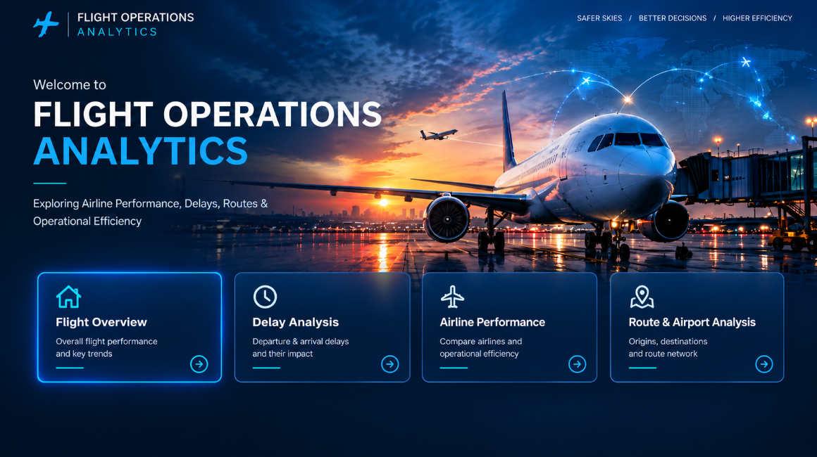
Power BI Dashboard — Cover Page
Phase 8 — landing page for the Flight Operations Analytics report
flight-operations-analytics.pbix — live view
WHAT THIS PAGE SHOWS
Branded landing page built around a flight-operations theme, setting the "Safer Skies, Better Decisions, Higher Efficiency" narrative for the report.
Four quick-navigation cards link straight into Flight Overview, Delay Analysis, Airline Performance and Route & Airport Analysis.
Establishes a consistent dark, aviation-styled visual identity carried through every page.

Slide 10
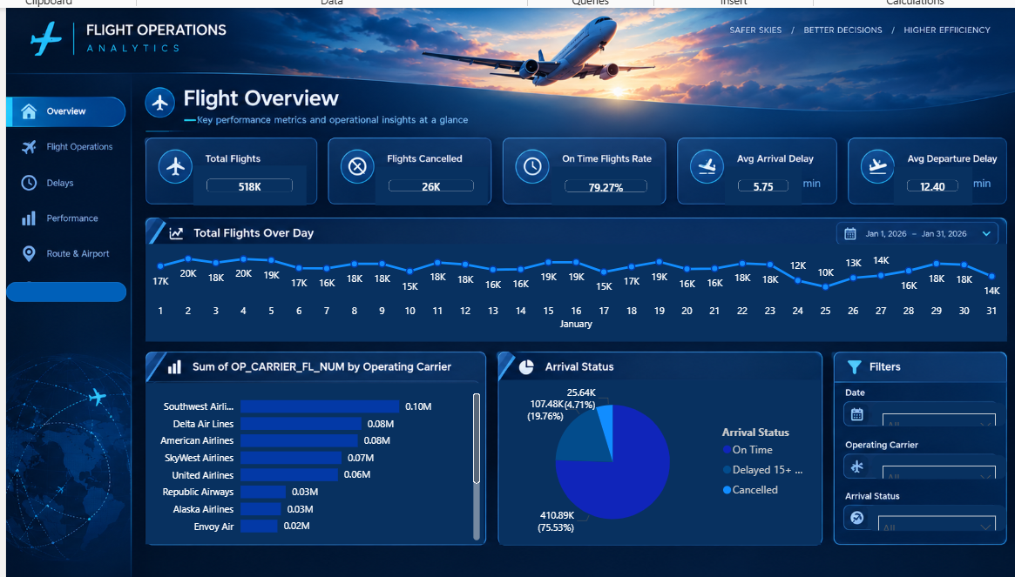
Power BI Dashboard — Flight Overview
Key performance metrics and operational insights at a glance
flight-operations-analytics.pbix — live view
AT A GLANCE
518K
79.27%
5.75 min
Total Flights
On-Time Rate
Avg Arrival Delay
WHAT THIS PAGE SHOWS
Daily flight-volume trend across January shows a clear weekday/weekend rhythm, dipping toward the low-teens (in thousands) on lighter days.
Southwest, Delta and American operate the largest share of flights among the 13 carriers.
Arrival status splits into 75.5% on-time, 19.8% delayed 15+ minutes and 4.7% cancelled.

Slide 11
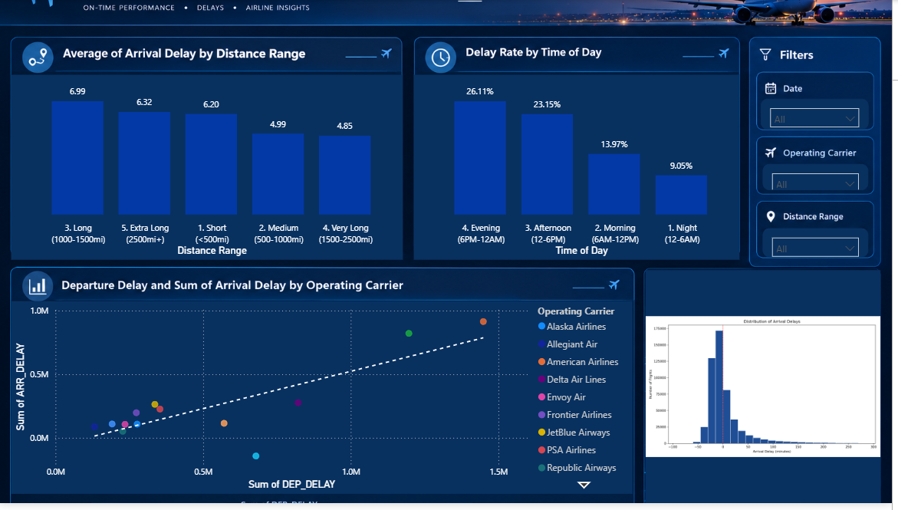
Power BI Dashboard — Delay Analysis
Departure & arrival delays and their impact
flight-operations-analytics.pbix — live view
AT A GLANCE
26.1%
~7 min
9.1%
Evening Delay Rate
Long-Haul Avg Delay
Overnight Delay Rate
WHAT THIS PAGE SHOWS
Longer-distance flights (1,000+ miles) see the highest average arrival delay, easing somewhat for very-long-haul routes.
Delay rate climbs through the day, peaking in the evening (26.1%) and falling sharply overnight (9.1%).
Departure delay tracks closely with arrival delay across carriers — confirming it as the strongest predictor identified in modelling.
The arrival-delay distribution is right-skewed, with a long tail of severely delayed flights.

Slide 12
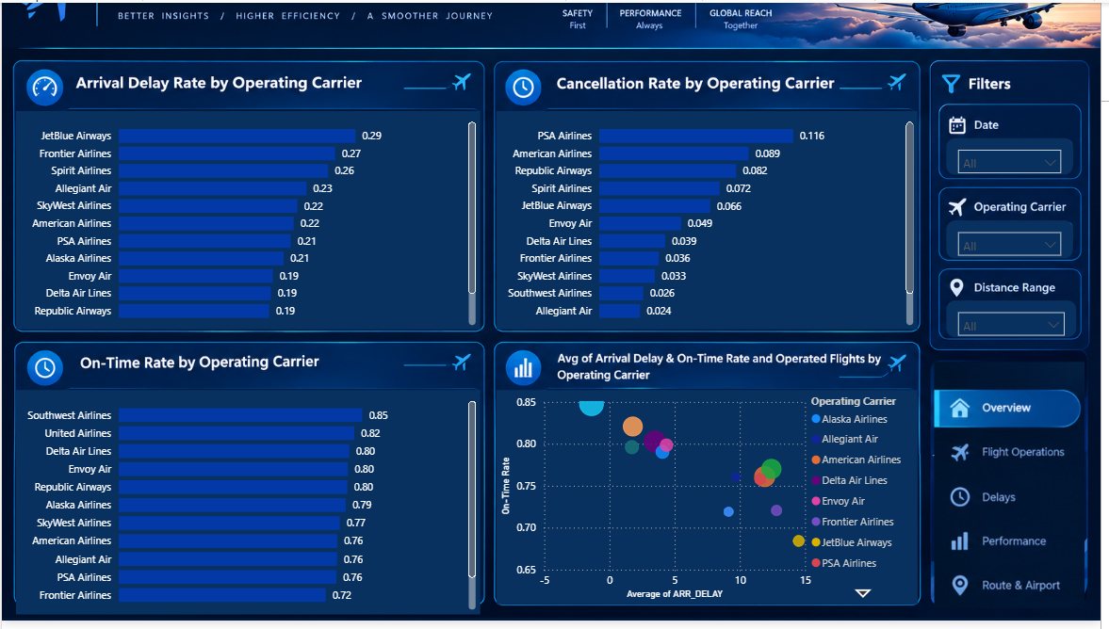
Power BI Dashboard — Airline Performance
Compare airlines and operational efficiency
flight-operations-analytics.pbix — live view
AT A GLANCE
85%
29%
11.6%
Best On-Time Rate
Highest Delay Rate
Highest Cancel Rate
WHAT THIS PAGE SHOWS
JetBlue (29%) and Frontier (27%) post the highest arrival-delay rates; Republic and Delta the lowest (19%).
Southwest leads on-time performance at 85%, followed by United at 82%.
PSA Airlines has the highest cancellation rate (11.6%); Allegiant the lowest (2.4%).
The bubble chart ties delay, on-time rate and flight volume together for a full efficiency view.

Slide 13
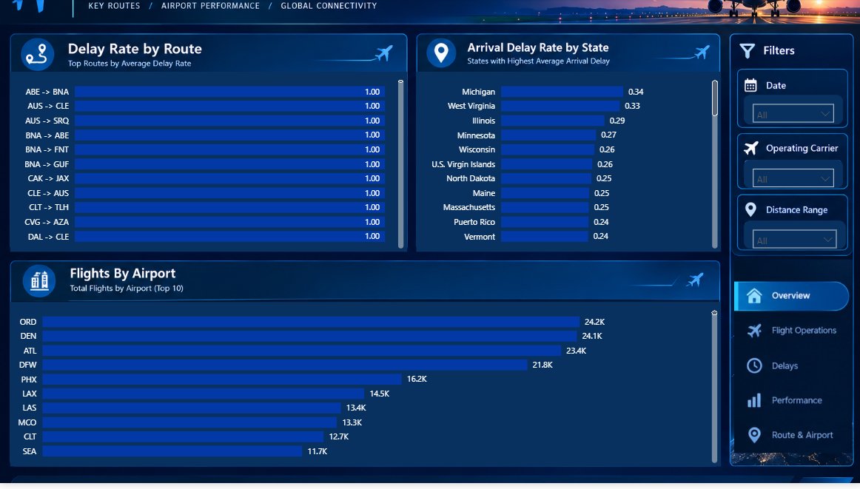
Power BI Dashboard — Route & Airport Analysis
Origins, destinations and route network
flight-operations-analytics.pbix — live view
AT A GLANCE
34%
24.2K
Top State Delay Rate
Busiest Airport (ORD)
WHAT THIS PAGE SHOWS
Several low-volume routes (e.g. ABE→BNA, AUS→CLE) show a 100% delay rate — small sample sizes worth flagging rather than raw ranking.
Michigan (34%) and West Virginia (33%) top the states with the highest average arrival delay.
Chicago O’Hare (24.2K), Denver (24.1K) and Atlanta (23.4K) are the busiest airports by total flights.

